Slide 1
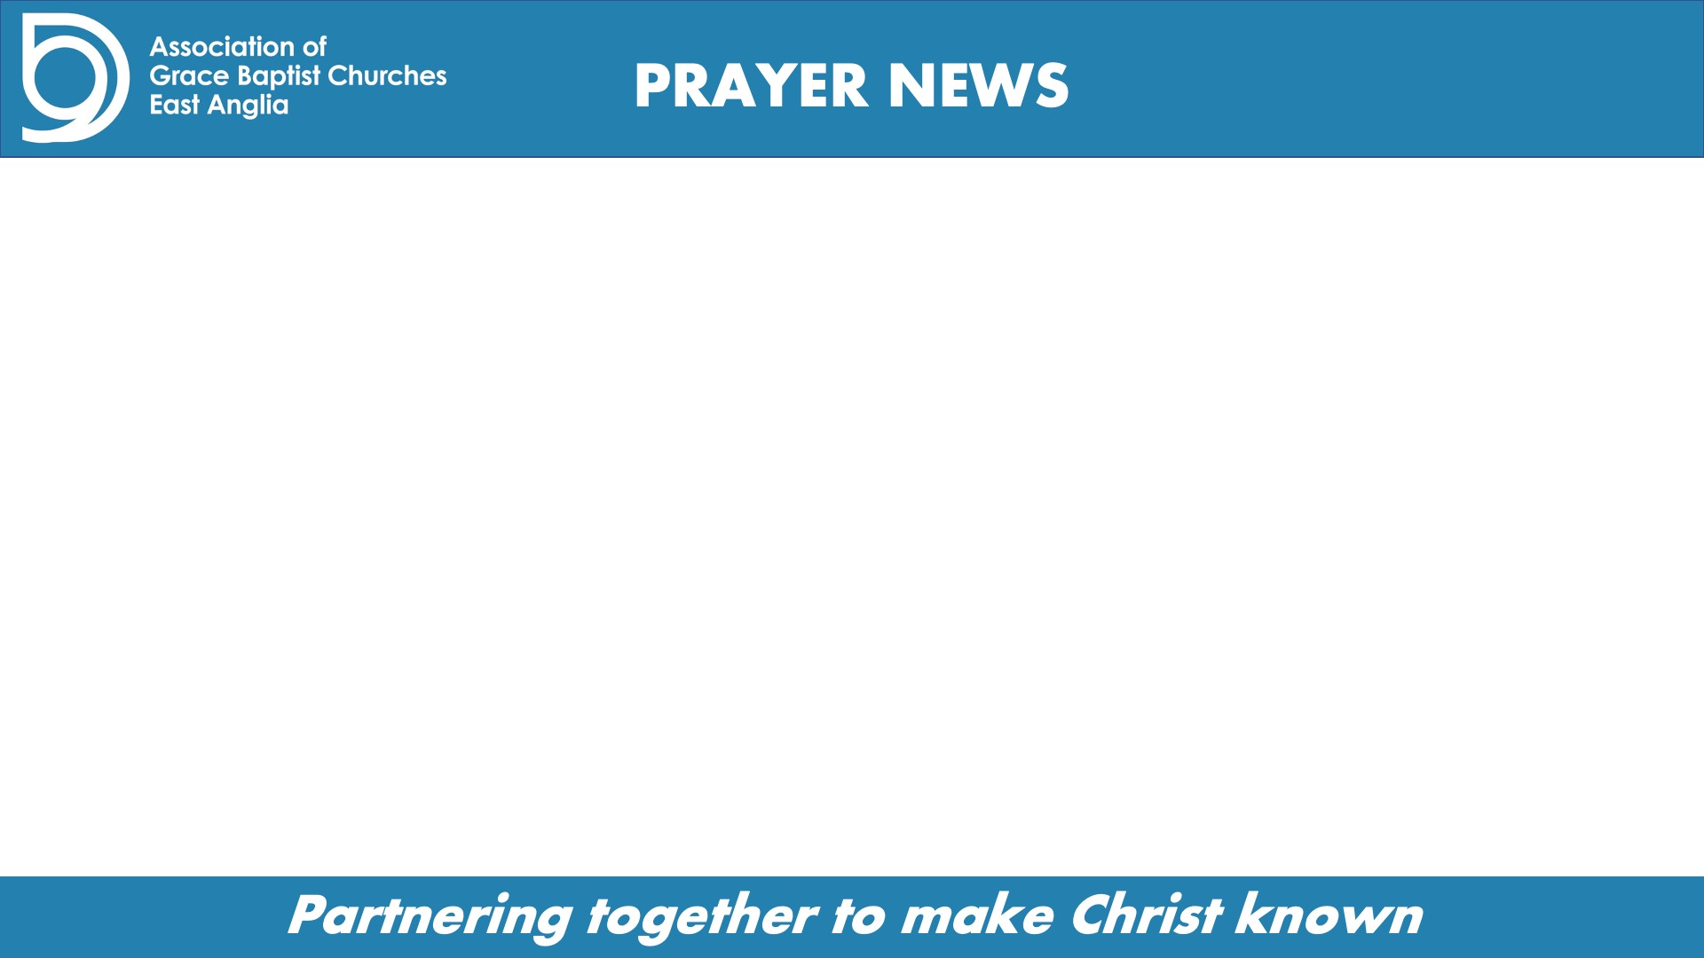
OUR ASSOCIATION OF CHURCHES
14th May 2023
Pray for the annual business meetings.
  For the delegates and chairs, for God’s wisdom and guidance in executing the agenda and in any decision making.
  That the meeting may provide a source of ever-deepening unity and fellowship across our association of churches.
Pray for the vision and aim of our Association - that we will together make Christ known.
Pray for Foundations (Finding Joy in Christ) and for Andy Fenton.
Thank God for each of the churches in our Association and pray that we may be bound together in love for our Lord and Father.

